Slide 1
DevOps and Cloud Batch
Day 04 Session(02/01/2025)
Final keyword
Encapsulation
Abstraction

Slide 2
Final keyword in java
The following are different contexts where the final is used:
Variable
Method
Class
When a variable is declared with the final keyword, its value can’t be changed, essentially, a constant. This also means that you must initialize a final variable.
Goto and const Keywords are not used in java, instead of const we use final keyword in java.

Slide 3
public class ConstantExample {
ConstantExample(double pi){
public static void main(String[] args) {
final double PI = 3.14159;
System.out.println("Value of PI: " + PI);
}
}
final attributes can be initialized when declared or with the help of constructors(default as well as parameterized)., these are the only to ways with which we can use to initialize final variables.

Slide 4
Pillars of OOPs:
Encapsulation :
Encapsulation is a way of hiding the implementation details of a class from outside access and only exposing a public interface that can be used to interact with the class.
In Java, encapsulation is achieved by declaring the instance variables of a class as private, which means they can only be accessed within the class.
To allow outside access to the instance variables, public methods called getters and setters are defined, which are used to retrieve and modify the values of the instance variables, respectively.
By using getters and setters, the class can enforce its own data validation rules and ensure that its internal state remains consistent.

Slide 5
Example of encapsulation
class Person {
private String name;
private int age;
public String getName() { return name; }
public void setName(String name) { this.name = name; }
public int getAge() { return age; }
public void setAge(int age) { this.age = age; }
}
public class Main {
public static void main(String[] args)
{
Person person = new Person();
person.setName("John");
person.setAge(30);
System.out.println("Name: " + person.getName());
System.out.println("Age: " + person.getAge());
}
}

Slide 6
Abstraction
Hiding the unnecessary details and displaying only the necessary details is known as abstraction.
Through encapsulation we can achieve abstraction.
Inheritence: For code reusability and to avoid duplication.
Types of Inheritence
Java Inheritance Types
Below are the different types of inheritance which are supported by Java.
Single Inheritance
Multilevel Inheritance
Hierarchical Inheritance
Multiple Inheritance
Hybrid Inheritance

Slide 7
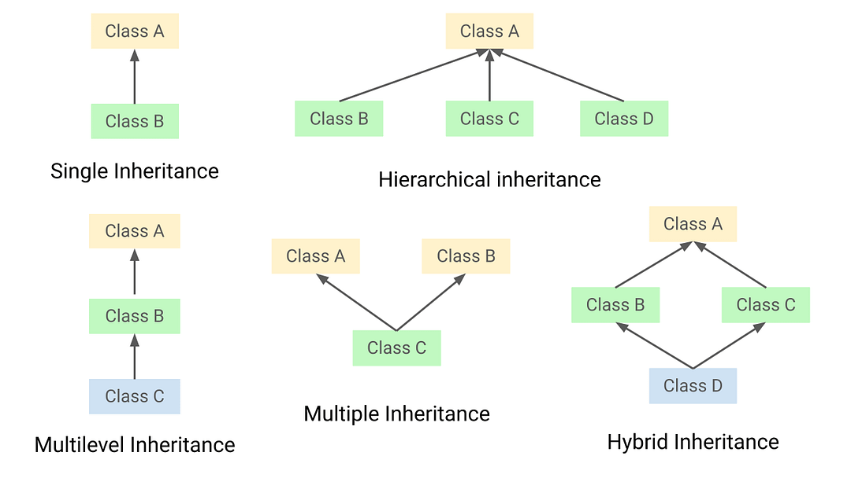

Slide 8
Types of Relationships :
Composition(has-a relationship): Relationship between a class and an object.
Generalization: Classes and object that has a common state and behavior.
Utilization(is-a relationship):One object makes use of other object or classes uses another class.
Instantiation: It defines that an object cannot exists without a class.
Extends establishes a relationship between two classes.
Syntax: <child class name> extends <Parent class name>{
}
Parent class can’t access child class properties.
Parent obj = new Child() – this is dynamic/run time polymorphism , but the vice versa is not possible.
Parent p: where ’p’ is just a reference variable not an object.
Multiple inheritance is not supported by java because it created ambiguity problems. It is also called a diamond problem.

Slide 9
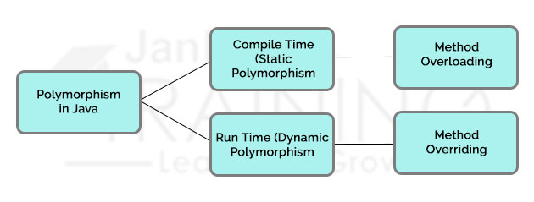
Polymorphism: Where poly means ‘many’ and morphism is ‘forms.’
Method Overloading: It is an example for static polymorphism. In Java means when there are multiple functions with the same name but different parameters then these functions are said to be overloaded. Functions can be overloaded by changes in the number of arguments or/and a change in the type of arguments or type of arguments.
Method Overriding: In Java known as Dynamic Method Dispatch. It is a process in which a function call to the overridden method is resolved at Runtime. This type of polymorphism is achieved by Method Overriding. Method overriding on the other hand, occurs when a derived class has a definition for one of the member functions of the base class. That base function is said to be overridden.

